Slide 1
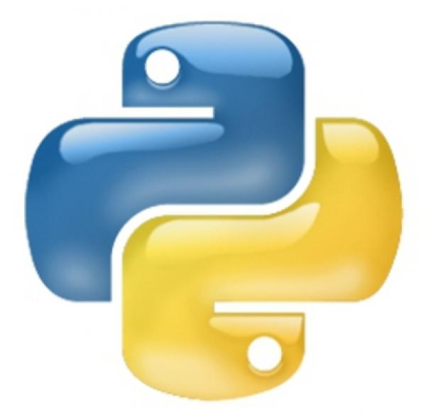
Python For BIG DATA ANALYTICS
View Mastering Python course details at http://www.edureka.co/python
For Queries:
Post on Twitter @edurekaIN: #askEdureka
Post on Facebook /edurekaIN
For more details please contact us:
US : 1800 275 9730 (toll free)
INDIA : +91 88808 62004
Email Us : sales@edureka.co

Slide 2
Objectives
At the end of this module, you will be able to
Understand Python
Understand Web Scrapping example using Python
Understand PyDoop: Python API for Hadoop
Implement Word Count example in Pydoop
Integrate Data Science with Python
Implement Zombie Invasion modeling using Python

Slide 3
Why Python?
Python is a great language for the beginner programmers since it is easy-to-learn and easy-to-maintain.
Python’s biggest strength is that the bulk of it’s library is portable. It also supports GUI Programming and can be used to create Applications portable on Mac, Windows and Unix X-Windows system.
With libraries like PyDoop and SciPy, it’s a dream come true for Big Data Analytics.

Slide 4
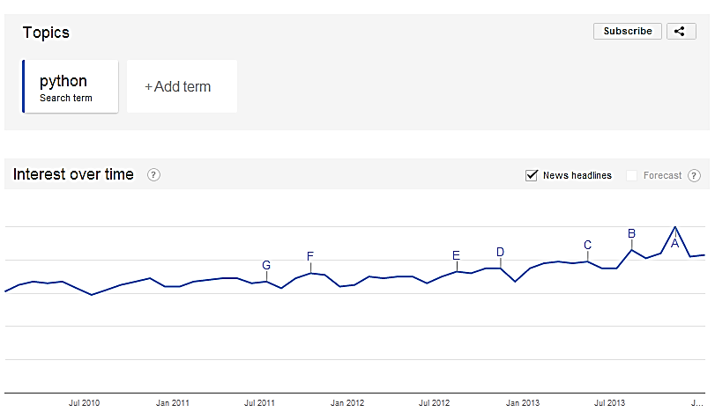
Growing Interest in Python

Slide 5
Demo: Web Scraping using Python
This example demonstrates how to scrape basic financial data from IMDB webpage
We shall use open source web scraping framework for Python called Beautiful Soup to crawl and extract data from webpages
Scraping is used for a wide range of purposes, from data mining to monitoring and automated testing

Slide 6

Demo: Collecting Tweets using Python
This example demonstrates how to extract historical tweets for a particular brand like “nike” or “apple”
We shall make a REST API call to twitter to extract tweets
This data can be further used to perform sentiment analysis for a particular brand on Twitter

Slide 7







Big Data
support
cloud
database
storage
Lots of Data (Terabytes or Petabytes)
Big data is the term for a collection of data sets so large and complex that it becomes difficult to process using on-hand database management tools or traditional data processing applications
The challenges include capture, curation, storage, search, sharing, transfer, analysis, and visualization
tools
statistics
analize
Big Data
information
No SQL
mobile
compression
processing
terabytes

Slide 8
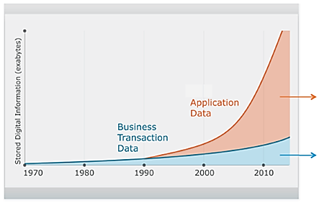
Un-Structured Data is Exploding
Complex, Unstructured
Relational
2500 exabytes of new information in 2012 with internet as primary driver
Digital universe grew by 62% last year to 800K petabytes and will grow to 1.2 “zettabytes” this year

Slide 9

Big Data Scenarios : Hospital Care
Hospitals are analyzing medical data and patient records to predict those patients that are likely to seek readmission within a few months of discharge. The hospital can then intervene in hopes of preventing another costly hospital stay
Medical diagnostics company analyzes millions of lines of data to develop first non-intrusive test for predicting coronary artery disease. To do so, researchers at the company analyzed over 100 million gene samples to ultimately identify the 23 primary predictive genes for coronary artery disease

Slide 10
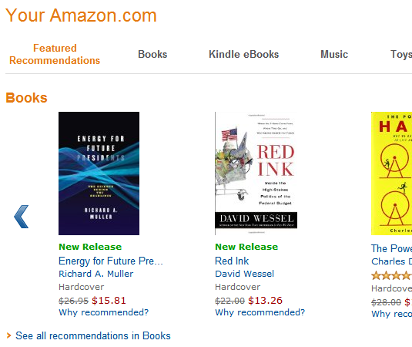
Big Data Scenarios : Amazon.com
Amazon has an unrivalled bank of data on online consumer purchasing behaviour that it can mine from its 152 million customer accounts
Amazon also uses Big Data to monitor, track and secure its 1.5 billion items in its retail store that are laying around it 200 fulfilment centres around the world. Amazon stores the product catalogue data in S3
S3 can write, read and delete objects up to 5 TB of data each. The catalogue stored in S3 receives more than 50 million updates a week and every 30 minutes all data received is crunched and reported back to the different warehouses and the website
http://wp.streetwise.co/wp-content/uploads/2012/08/Amazon-Recommendations.png

Slide 11
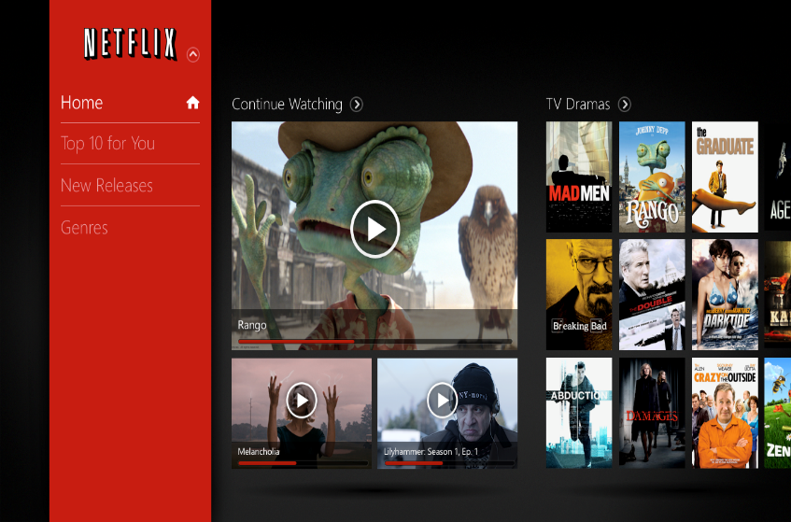
Big Data Scenarios: NetFlix
Netflix uses 1 petabyte to store the videos for streaming
BitTorrent Sync has transferred over 30 petabytes of data since its pre-alpha release in January 2013
The 2009 movie Avatar is reported to have taken over 1 petabyte of local storage at Weta Digital for the rendering of the 3D CGI effects
One petabyte of average MP3-encoded songs (for mobile, roughly one megabyte per minute), would require 2000 years to play
http://smhttp.23575.nexcesscdn.net/80ABE1/sbmedia/blog/wp-content/uploads/2013/03/netflix-in-asia.png

Slide 12
IBM’s Definition
IBM’s Definition – Big Data Characteristics
http://www-01.ibm.com/software/data/bigdata/
Web logs
Audios
Images
Videos
Sensor Data
Volume
Velocity
Variety

Slide 13

Hadoop for Big Data
Apache Hadoop is a framework that allows for the distributed processing of large data sets across clusters of commodity computers using a simple programming model
It is an Open-source Data Management with scale-out storage & distributed processing

Slide 14
Hadoop and MapReduce
Hadoop is a system for large scale data processing
It has two main components:
HDFS – Hadoop Distributed File System (Storage)
Distributed across “nodes”
Natively redundant
NameNode tracks locations
MapReduce (Processing)
Splits a task across processors
“near” the data & assembles results
Self-Healing, High Bandwidth
Clustered storage
Job Tracker manages the Task Trackers
Key
Value
Map-Reduce

Slide 15

PyDoop – Hadoop with Python
Python can be used to write Hadoop MapReduce programs and applications to access HDFS API for Hadoop with PyDoop package
PyDoop package provides a Python API for Hadoop MapReduce and HDFS
PyDoop has several advantages over Hadoop’s built-in solutions for Python programming, i.e., Hadoop Streaming and Jython
One of the biggest advantage of PyDoop is it’s HDFS API. This allows you to connect to an HDFS installation, read and write files, and get information on files, directories and global file system properties
The MapReduce API of PyDoop allows you to solve many complex problems with minimal programming efforts. Advance MapReduce concepts such as ‘Counters’ and ‘Record Readers’ can be implemented in Python using PyDoop

Slide 16
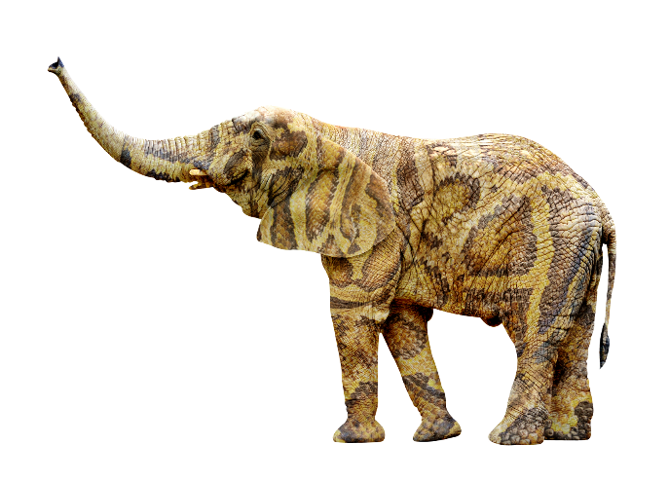
Demo: Word Count using Hadoop Streaming API
The example shows the simple word count application written in Python
We shall use Hadoop Streaming APIs to run MapReduce code written in Python
Word Count application can be used to index text documents/files for a given “search query”

Slide 17
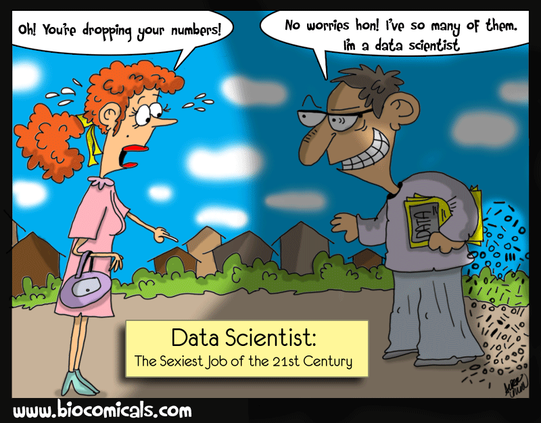
Python and Data Science
The day-to-day tasks of a data scientist involves many interrelated but different activities such as accessing and manipulating data, computing statistics and , creating visual reports on that data, building predictive and explanatory models, evaluating these models on additional data, integrating models into production systems, etc.
Python is an excellent choice for Data Scientist to do his day-to-day activities as it provides libraries to do all these things
Python has a diverse range of open source libraries for just about everything that a Data Scientist does in his day-to-day work
Python and most of its libraries are both open source and free

Slide 18
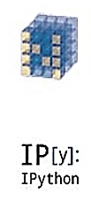
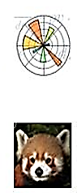

SciPy.org
SciPy (pronounced “Sigh Pie”) is a Python-based ecosystem of open-source software for mathematics, science, and engineering.
NumPy
Base N-dimensional
array package
SciPy library
Base N-dimensional
array package
Matplotlib
Comprehensive 2D Plotting
IPython
Enhanced Interactive
Console
pandas
Data structures and analysis
Sympy
Symbolic mathematics

Slide 19
Demo: Zombie Invasion Model
This is a lighthearted example, a system of ODEs(Ordinary differential equations) can be used to model a "zombie invasion", using the equations specified by Philip Munz.
The system is given as:
dS/dt = P - B*S*Z - d*S
dZ/dt = B*S*Z + G*R - A*S*Z
dR/dt = d*S + A*S*Z - G*R
There are three scenarios given in the program to show how Zombie Apocalypse vary with different initial conditions.
This involves solving a system of first order ODEs given by: dy/dt = f(y, t) Where y = [S, Z, R].
Where:
S: the number of susceptible victims
Z: the number of zombies
R: the number of people "killed”
P: the population birth rate
d: the chance of a natural death
B: the chance the "zombie disease" is transmitted (an alive person becomes a zombie)
G: the chance a dead person is resurrected into a zombie
A: the chance a zombie is totally destroyed

Slide 20
How it Works?

Slide 21
Course Topics
Module 6
Machine Learning Using Python – I
Module 7
Machine Learning Using Python – II
Module 8
Introduction to Hadoop
Module 9
Hadoop and Python
Module 10
Web Scraping using Python and Project Work
Module 1
Getting Started with Python
Module 2
Sequences and File Operations
Module 3
Deep Dive - Functions, Sorting, Errors and Exception Handling
Module 4
Regular Expressions, its Packages and Object Oriented Programming in Python
Module 5
Debugging, Databases and Project Skeletons

